Slide 1


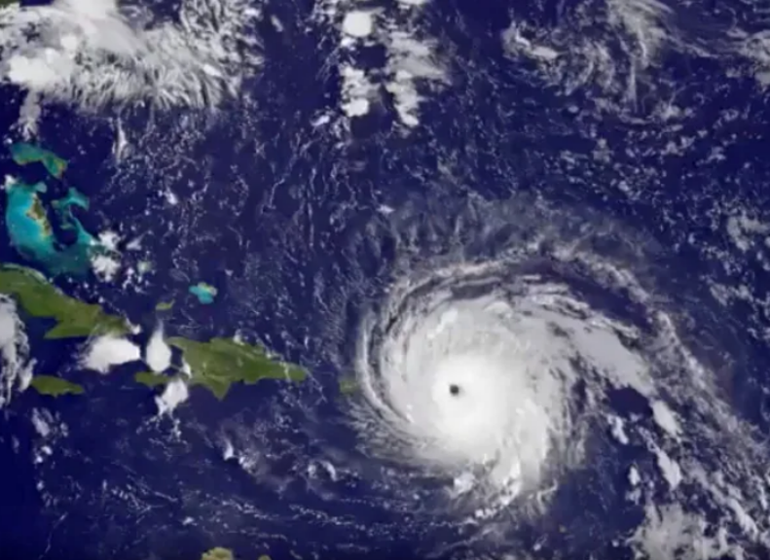
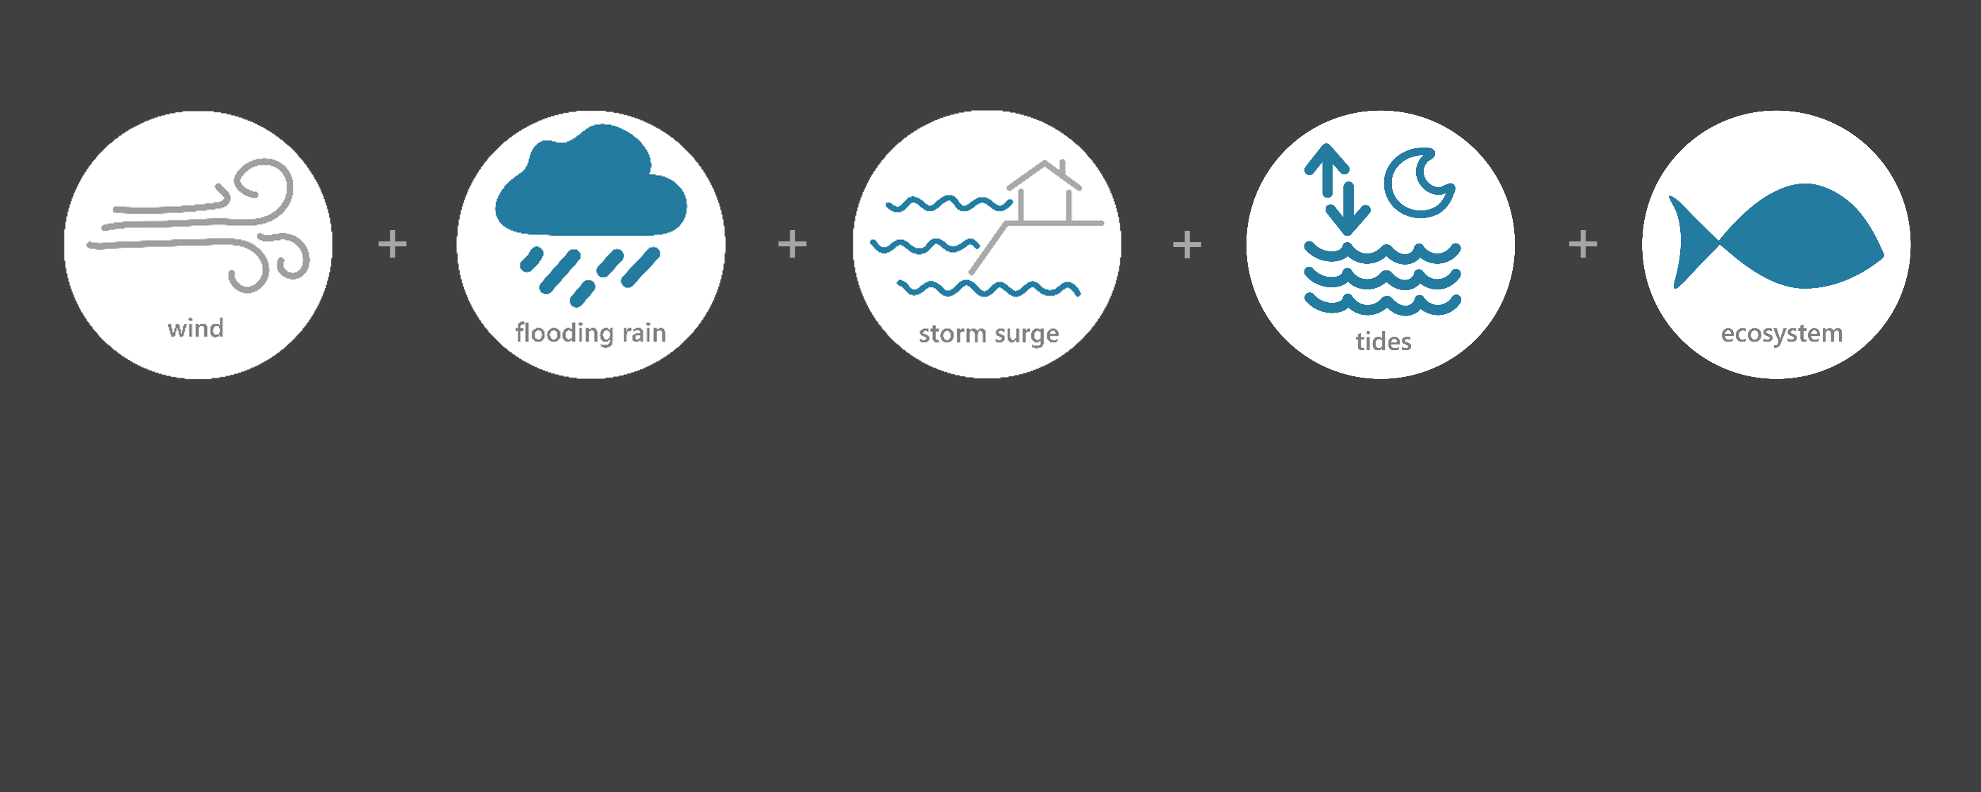

[ SEP 5 – SEP 9, 2017 ]
HURRICANE IRMA
5
Category (catastrophic)
2
Inches of Rain
25.7
Miles per hour of Max Wind Speed
1.1
Feet of Storm Surge*
Image Credit: NASA NOAA GOES, taken on September 6, 2017
Monitoring the Impact of Hurricane Irma at “Jobos Bay NERR”
Culebra, Vieques, and mainland Puerto Rico began to experience sustained tropical storm forced winds as the center of Irma approached on Sep. 7. Although the majority of the rainbands of the hurricane-affected Puerto Rico and the US Virgin Islands, the eyewall remained just north of mainland Puerto Rico. In general, most of mainland Puerto Rico only observed sustained tropical storm forced winds.
The effects of Irma were observed at the Jobos Bay NERR (JBNERR) Research Reserve through the System-Wide Monitoring Program (SWMP), which tracks short-term variability and long-term change of weather and water quality in the areas surrounding the southern coast of Puerto Rico.
Data shown are based on the JBNERR weather monitoring site
*Data based on the Yabucoa Harbor NOS site
Created on May 31, 2022

Slide 2

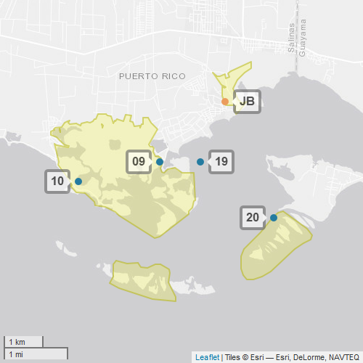
JBNERR
Jobos Bay NERR (JBNERR) is one of 30 sites in the National Estuarine Research Reserve Systems (NERRS). Each site is a state-federal partnership that combines research, monitoring, and education to advance the understanding and management of estuarine environments.
NERRS
Centralized Data
Management Office
JBNERR
JBNERR Storm Monitoring
Weather Station
JBNERR operates a weather station located at Jobos Bay (JB) and maintains four continuous, long-term water quality stations including Station 9, Station 10, Station 19, and Station 20. JBNERR is part of the SWMP. As Hurricane Irma approached Puerto Rico, JBNERR monitored the weather and water quality, collecting data every 15 minutes for the following parameters: air temperature, relative humidity, atmospheric pressure, rainfall, wind speed and direction, water temperature, depth, salinity, dissolved oxygen, turbidity, and pH.
Water Quality Sample Location

Slide 3
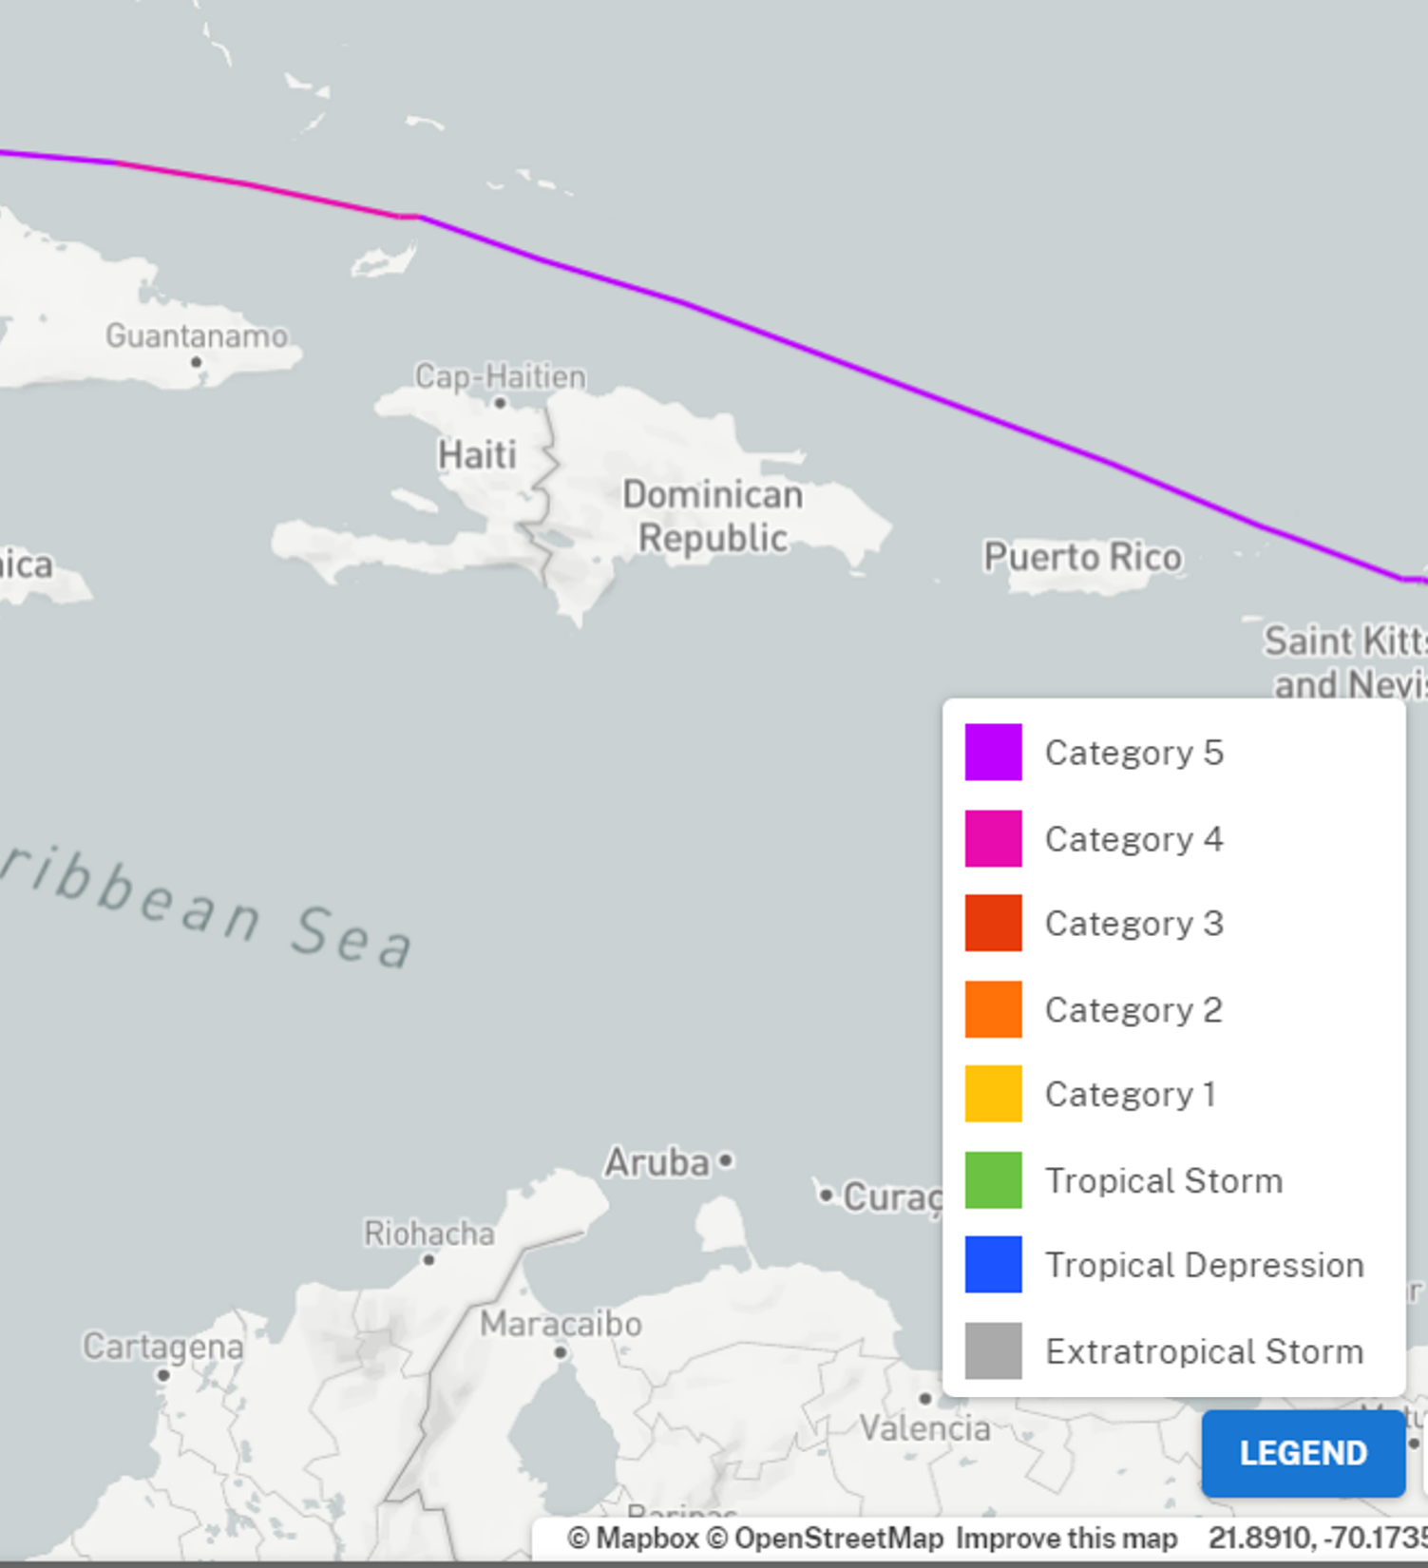
Irma made its third landfall on the island of Virgin Gorda in the British Virgin Islands Sep. 6 as a Category 5 hurricane. The eye of Irma tracked about 50 n mi to the north of the northern shore of Puerto Rico and the Dominican Republic from Sep. 6 to Sep. 7.
Heavy rains caused widespread power outages and minor damage to homes and businesses. Weak structures on the island collapsed and numerous trees were uprooted. There was also a near-total loss of electricity and water supply for several days. Three indirect deaths occurred in Puerto Rico from Hurricane Irma.
Source: https://oceanservice.noaa.gov/news/historical-hurricanes/
JBNERR
Irma caused more than an estimated $700 million in damage.
Irma was Category 5 as it passed north of mainland Puerto Rico. Even though Puerto Rico and the reserve did not experience a direct hit from Irma, weather impacts were still felt from rain, wind, and storm surge.
Aquatic life (i.e., oysters, crabs, lobster, fish, aquatic plants, phytoplankton) rely on specific levels of salinity and dissolved oxygen to thrive and survive. Significant drops in salinity levels and dramatic changes to the typical diurnal variation of dissolved oxygen can potentially stress organisms. However, the water quality in the reserve was minimally impacted by Irma.
Station | Date | Total Precipitation (in) | Average Precipitation Intensity (in) | Max Wind Speed (mph) | Average Wind Speed (mph)
Jobos Bay Weather | 9/5/2017 | 0.45 | 0.0238 | 19.7 | 4.2
Jobos Bay Weather | 9/6/2017 | 1.01 | 0.0422 | 25.7 | 8.2
Jobos Bay Weather | 9/7/2017 | 0.36 | 0.0151 | 25.7 | 14.7
Jobos Bay Weather | 9/8/2017 | 0.17 | 0.0069 | 18.3 | 10.1
Jobos Bay Weather | 9/9/2017 | 0.00 | 0.0000 | 17.7 | 6.7
The highest local rainfall and wind measurements were recorded as Irma approached north of the mainland island
on Sep. 6.
Data reporting time periods for Hurricane Irma: 9/5/2017 - 9/9/2017

Slide 4
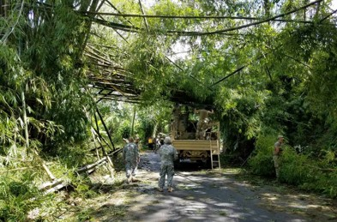
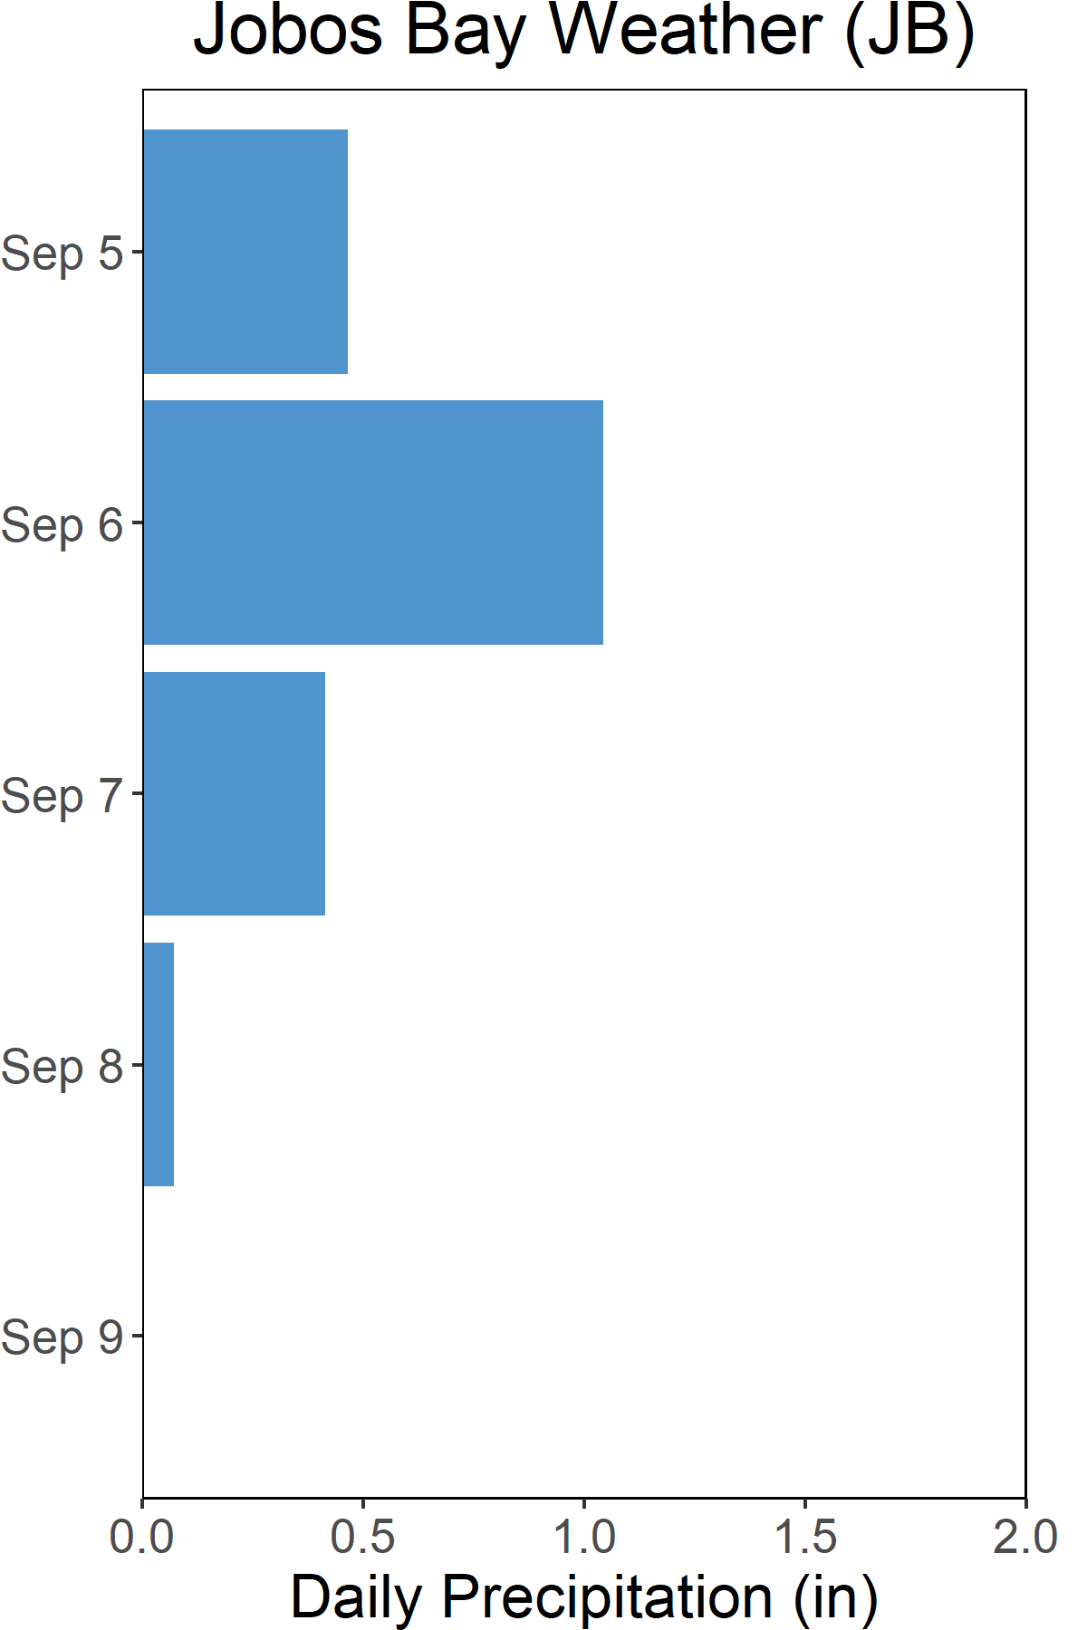
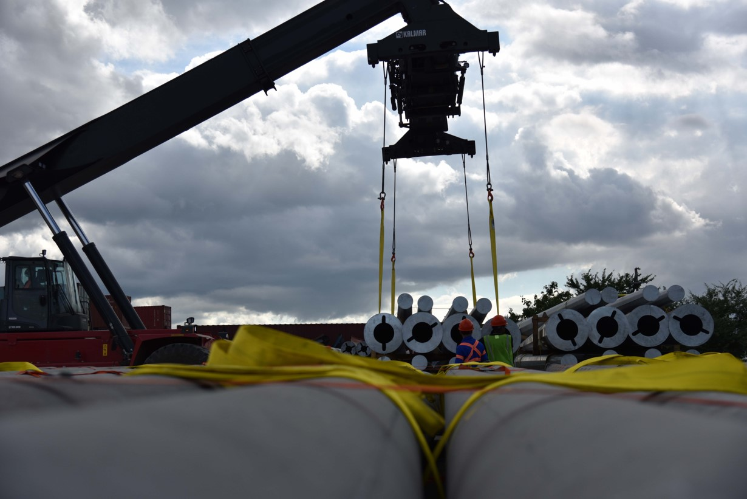
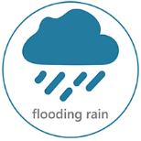
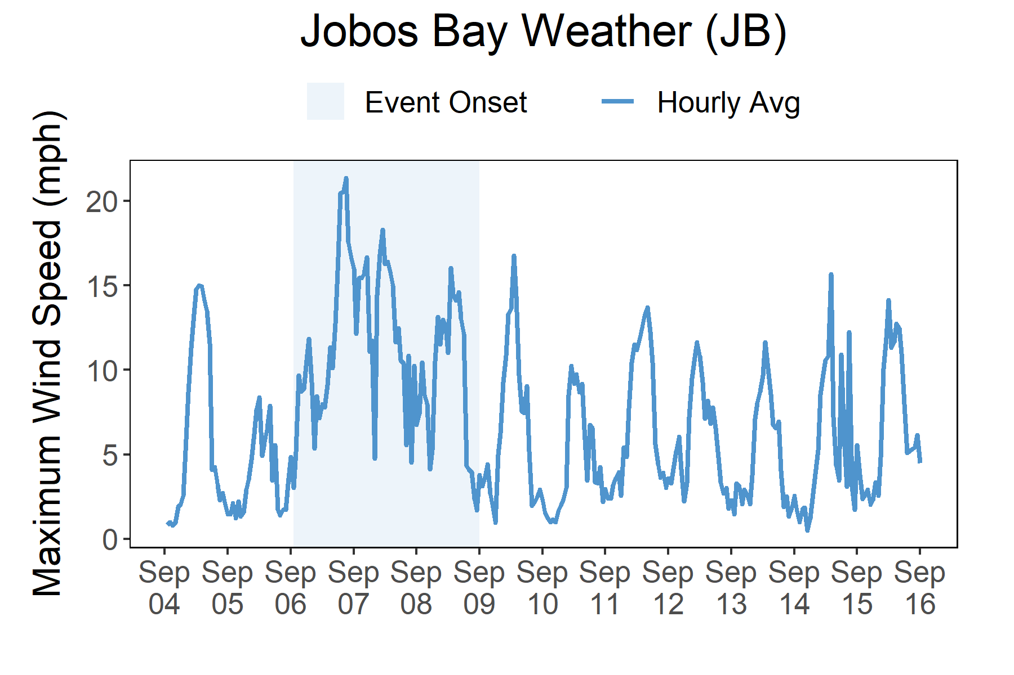

Rainfall
Irma brought rain, high winds, and storm surge flooding to Puerto Rico.
A total of 2 inches of rainfall fell in the reserve area over the course of four days from the rain-producing Hurricane Irma
A total of 2 total inches of rainfall and a max wind speed of 25.7 mph were recorded at the Jobos Bay weather station. Even though Puerto Rico did not experience a direct hit from Irma, rainfall totals between 10 and 15 inches occurred over high elevations in the central portion of the island between Sep. 5 and Sep. 7. The highest wind speed reported in Puerto Rico was 55.2 mph with a gust of 73.6 mph at an NOS site at La Puntilla in San Juan Bay on Sep. 6. Maximum inundation levels of 1 to 2 ft above ground level occurred along the coast of Puerto Rico.
Although Irma’s eyewall passed to the north of Puerto Rico, tropical-storm-force winds and heavy rains caused widespread power outages and minor damage to homes and businesses. Weak structures on the island collapsed and numerous trees were uprooted. There was also a near-total loss of electricity and water supply for several days. Three indirect deaths occurred in Puerto Rico from Hurricane Irma. On the island of Culebra, there was also a near-total power and water loss. Many homes on the island were destroyed or suffered major damage, and widespread uprooted trees were reported.
Rainfall measurements at the Jobos Bay weather station from Sep. 5 through Sep. 9.
Wind Speed
Max wind speed recorded at the reserve was 25.7 mph on Sep. 6 and Sep. 7.
Maximum Wind Speed readings at the Jobos Bay weather station from Sep. 4 through Sep. 16.

Slide 5
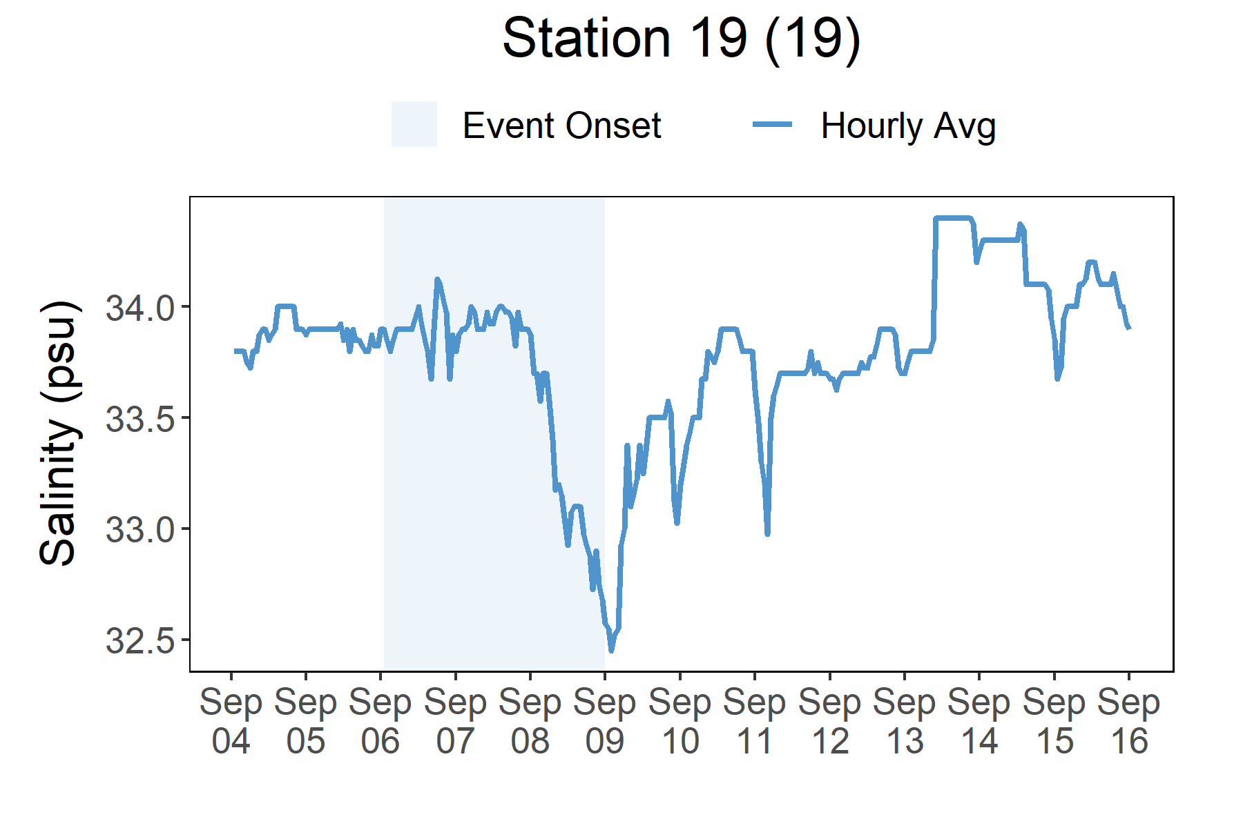
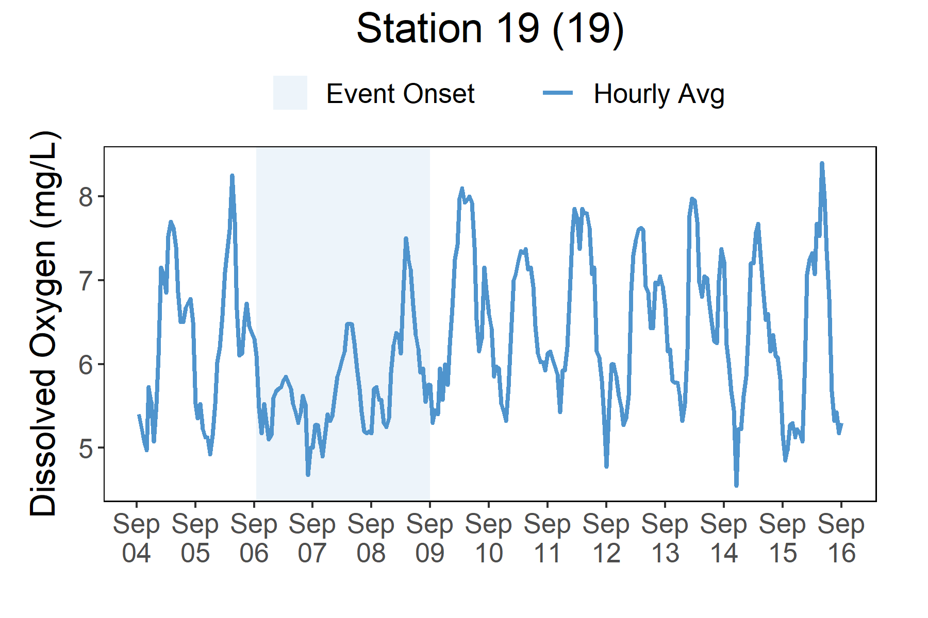
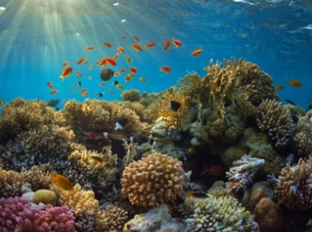
Overall, there was not a strong water quality impact from Hurricane Irma. Salinity levels at Station 19 descreased slightly on Sep. 8 and then quickly returned to pre-storm levels by Sep. 10.
Station | Date | Turbidity Maximum (NTU) | Salinity Minimum (psu) | Salinity Maximum (psu) | Dissolved Oxygen Minimum (mg/L) | Dissolved Oxygen Maximum (mg/L)
Station 19 | 9/6/2017 | 6 | 33.6 | 34.2 | 4.9 | 6.9
Station 19 | 9/7/2017 | 6 | 33.3 | 34.1 | 4.5 | 6.5
Station 19 | 9/8/2017 | 3 | 32.8 | 34.0 | 5.0 | 7.6
Station 19 | 9/9/2017 | 8 | 32.4 | 33.5 | 5.1 | 8.2
Station 19 | 9/10/2017 | 2 | 32.9 | 33.9 | 5.0 | 7.5
Data reporting time periods for Hurricane Irma: 9/5/2017 - 9/9/2017
Salinity
Dissolved Oxygen
Dissolved oxygen levels
decreased slightly during the storm
Salinity decreased slightly
following the storm
Salinity levels from Sep. 4 to Sep.16
Dissolved oxygen levels from from Sep. 4 to Sep.16
Salinity and Dissolved Oxygen levels that were recorded at the Jobos Bay NERR Station 19 show initial and post-storm water quality in this area. Overall, water quality does not appear to be significantly impacted at this location. Salinity levels decreased slightly after the strom passed but quickly returned to pre-storm levels. Dissolved oxygen levels decreased slightly from Sep. 6 to Sep. 8 but then returned to pre-storm levels by Sep. 9. Dramatic changes in salinity and lower levels of oxygen can cause stress to some aquatic organisms depending on the species and how long the levels deviate from what is normal. Water quality stresses can impact survival and future populations. However, dramatic changes were not observed for Hurricane Irma.
Every plant and animal species have habitat preferences and requirements. Understanding these habitats is critical to understanding populations.

Slide 6
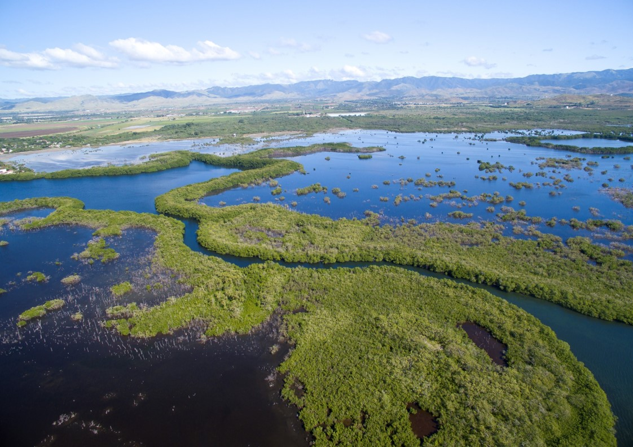
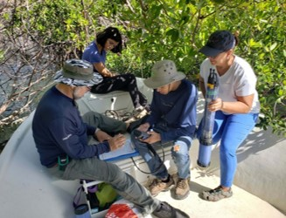
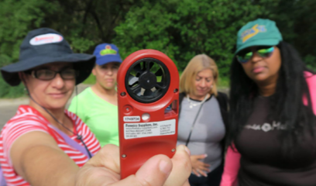
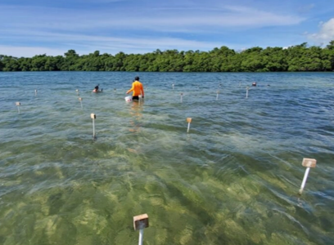
Angel Dieppa, Research and Monitoring Coordinator e: adieppa.jbnerr@gmail.com p: 787.999.2200
Visit www.nerrsdata.org to view and download weather and water quality data from Jobos Bay NERR.
Interested in learning more? Visit https://www.drna.pr.gov/jbnerr/. For video, news updates, online storm data and prediction visualization tools, check out our Storm Story Map at www.storm storymap.url.
@drnapr

